Slide 1

NOUN

Slide 2

Collective Noun
Collective noun / Praveena

Slide 3
Collective Noun
A collective noun is a name given to groups of similar things, persons or animals

Slide 4


Slide 5
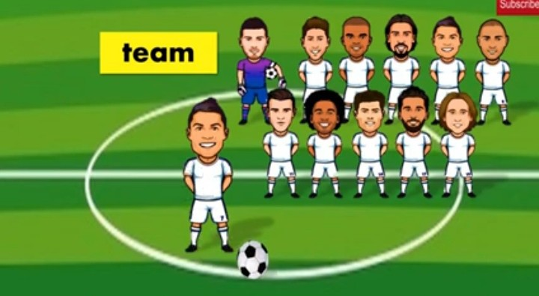
a team of players

Slide 6
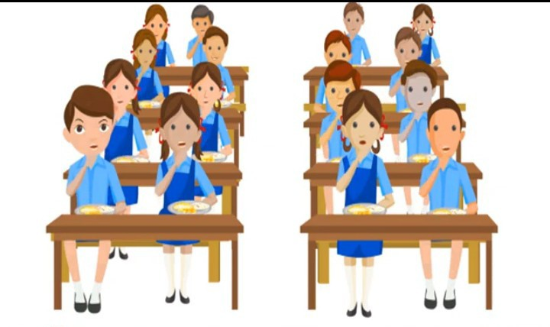
a class of students

Slide 7

a crew of sailors

Slide 8

a string of pearls

Slide 9
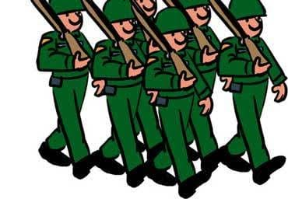
an army of soldiers

Slide 10
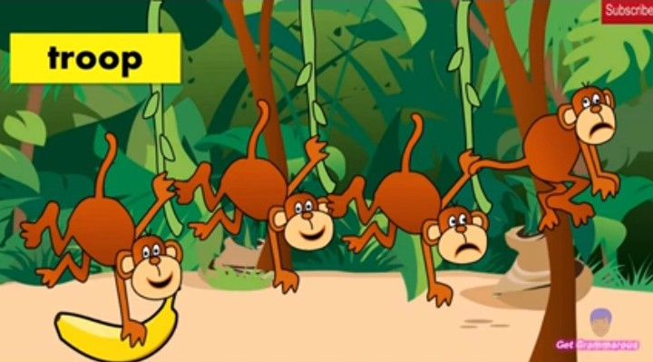
a troop of monkeys

Slide 11
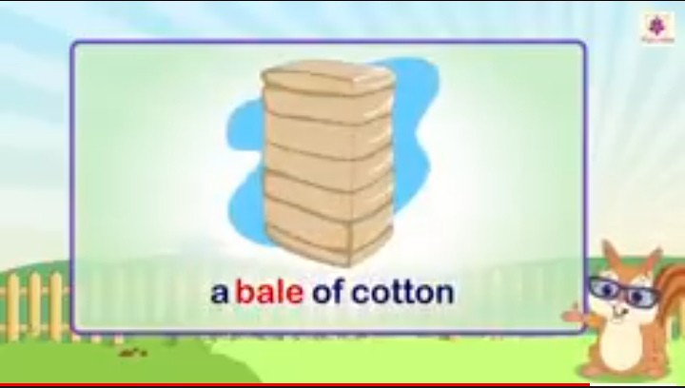

Slide 12
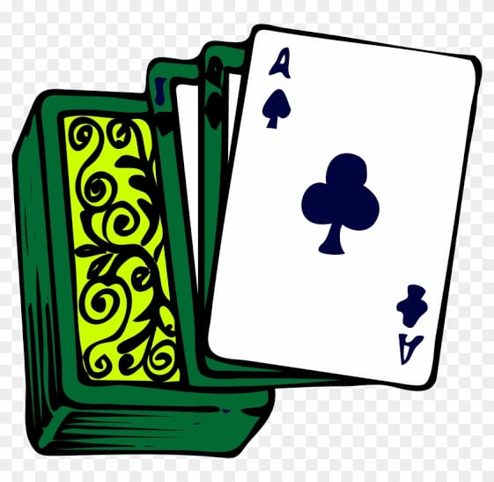
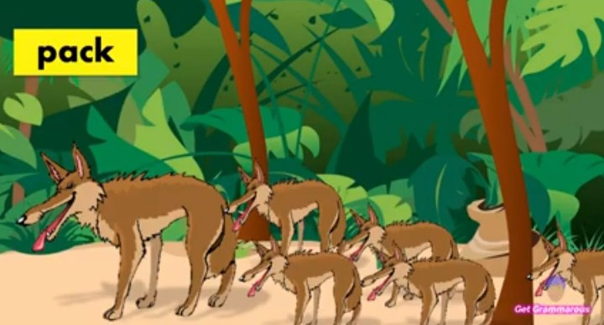
a pack of cards/wolves

Slide 13
a team of players

Slide 14
a class of students

Slide 15
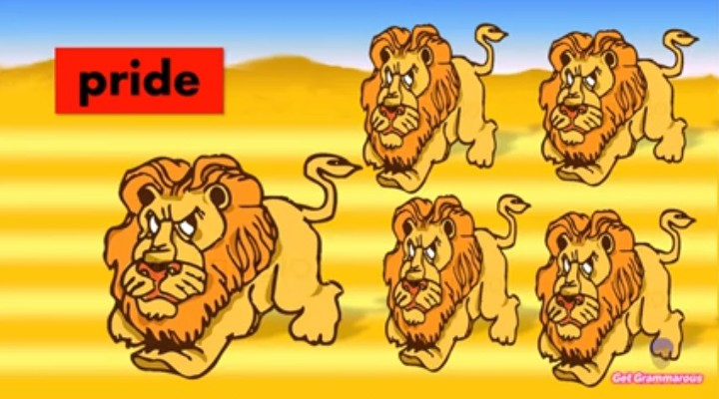
a pride of lions

Slide 16

a bouquet of flowers

Slide 17
a pack of cards/wolves

Slide 18

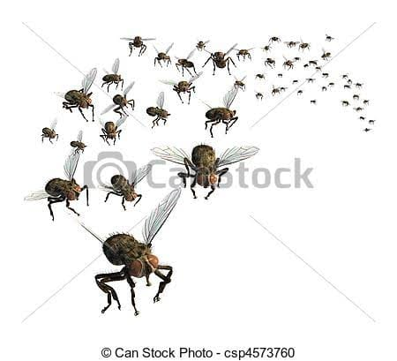
a swarm of bees/insects

Slide 19
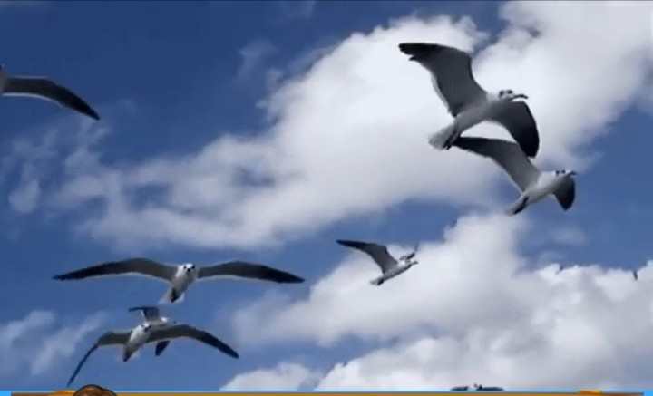
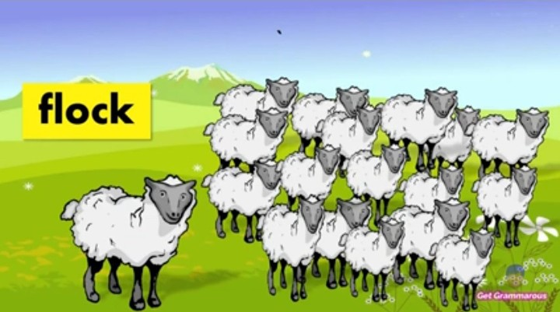
a flock of birds/sheep

Slide 20

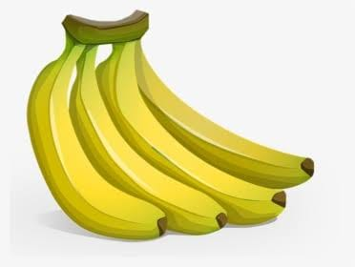
a bunch of keys/grapes/bananas

Slide 21
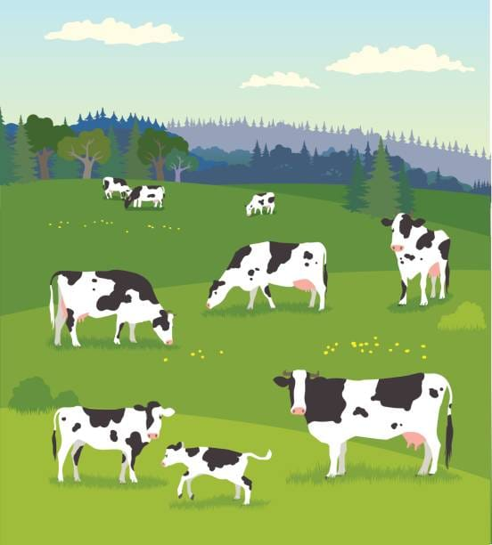
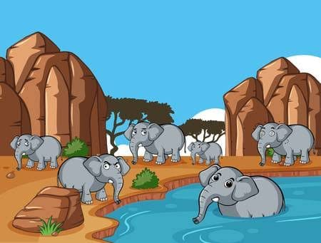
a herd of cattle/elephants

Slide 22
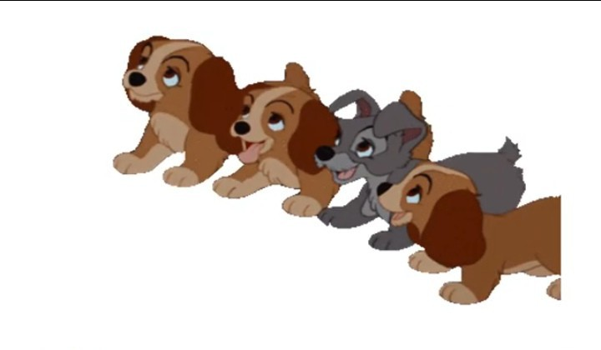
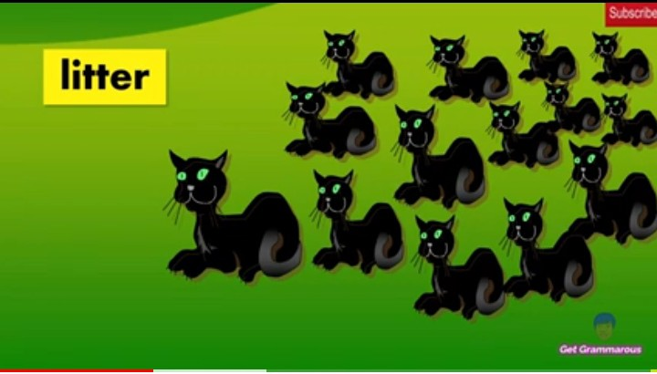
a litter of puppies/kittens

Slide 23
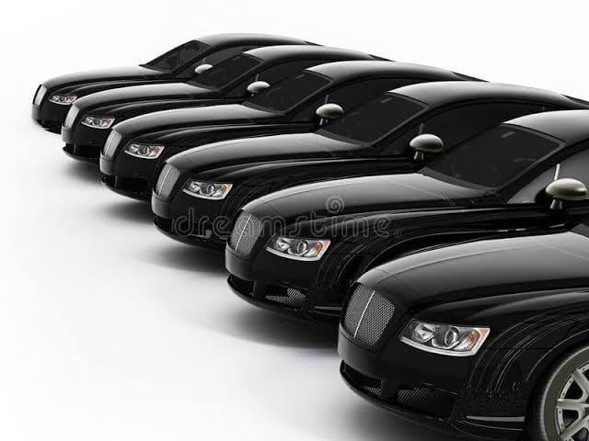

a fleet of cars/ships

Slide 24
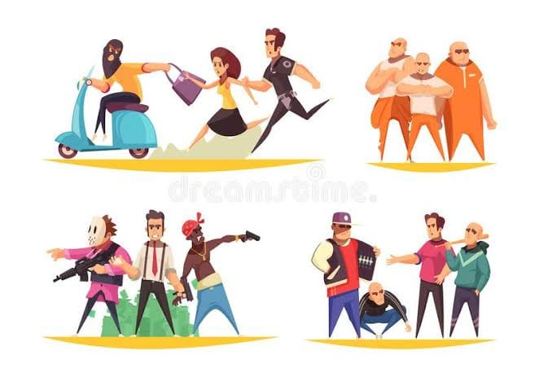
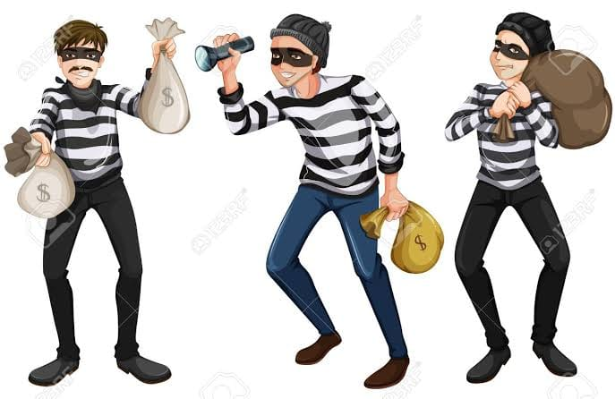
a gang of robbers/thieves

Slide 25
HOMEWORK
I. Fill in the blanks with the collective nouns.
a ________ of birds/sheep.
a ________ of keys/grapes/bananas.
a ________ of cattle/elephants.
a ________ of cards/wolves.
a ________ of ships/cars.
a ________ of bees/ insects.
a ________ of kittens/puppies.
a ________ of robbers/thieves.
COLLECTIVE NOUN/ PRAVEENA/FACULTY

Slide 26
THANK YOU

